Slide 1
Data Preprocessing
Essential Steps for Preparing Data Before Modeling

Slide 2
Introduction
Data preprocessing is a crucial step in the machine learning and statistical analysis pipeline.
It involves transforming raw data into a clean and usable format, ensuring that the data is consistent, accurate, and relevant for the analysis.
Here are the key reasons why data preprocessing is essential:
Improving Data Quality
Enhancing Model Performance
Improving Interpretability
Ensuring Consistency

Slide 3
Basic Steps in Data Preprocessing
Step 1 :Import important libraries
Step 2: Import dataset
Step 3: Preprocessing:
Find duplicates
Missing value treatment
Encoding
Feature scaling
Handling data types
Outlier treatment
Data balancing
Feature Selection

Slide 4
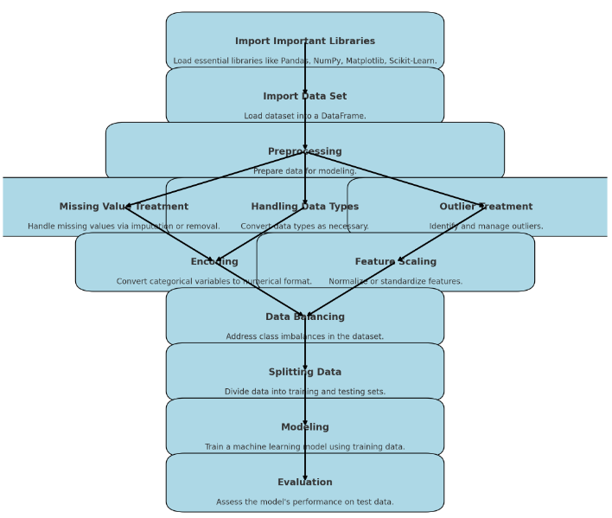

Slide 5
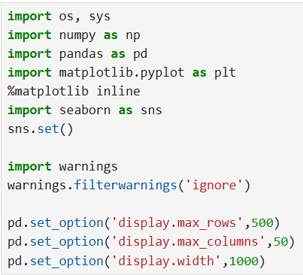
Import Important Libraries

Slide 6
Purpose of Libraries
os: Functions to interact with the operating system.
Example Usage: os.listdir() lists files and directories in the specified path.
numpy: Support for arrays, matrices, and mathematical functions.
pandas: Data manipulation and analysis.
matplotlib & seaborn: Data visualization.
warnings: Manage warning messages in code.
sns.set(): Automatically sets the seaborn plot aesthetics to a default theme.
%matplotlib inline: A magic command used in Jupyter notebooks to display matplotlib plots inline within the notebook.

Slide 7
Importing Data
Data = pd.read_csv(r"C:\\Desktop\\DataScience\\data.csv“)
Data = pd.read_csv(r"C:/Desktop/DataScience/data.csv“)
Data.head()
Data.tail()

Slide 8

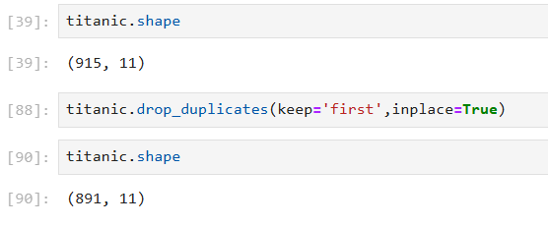
Finding and Handling Duplicate
If there is any kind of repetition of data in dataset than it is required to remove them for healthy analysis and prediction.

Slide 9
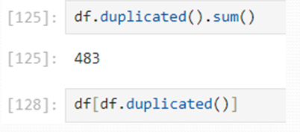
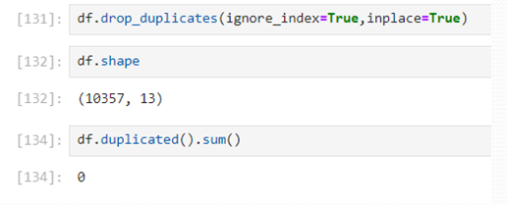
Handling Duplicates

Slide 10
Handling Missing Values
Identifying missing values using `df.isnull().sum()`.
In percentage form: df.isnull().sum()/len((df)*100
Techniques to handle missing values:
If any variable have missing value > 25% , drop it.
data = data.drop([‘name of column’], axis = 1)
- Else Imputing missing values

Slide 11
Imputation Method
Various imputation Approaches are:
Simple Statistical Imputation:
Mean: If no outliers.
Median:If data have outliers.
Mode : If variables are categorical type.
KNN imputation: Replaces missing values based on the mean or median of the nearest neighbors' values.

Slide 12
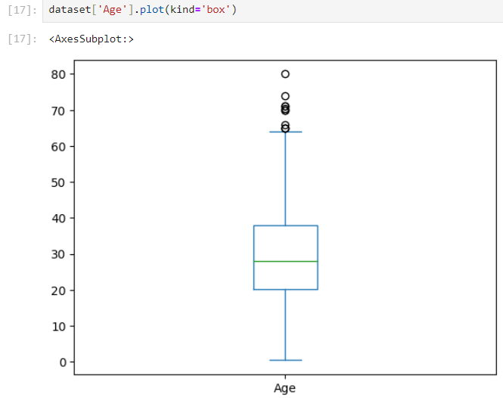

Slide 13
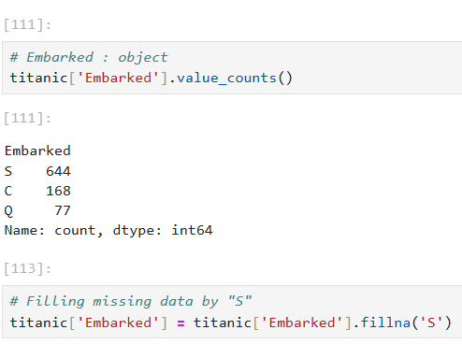

Slide 14
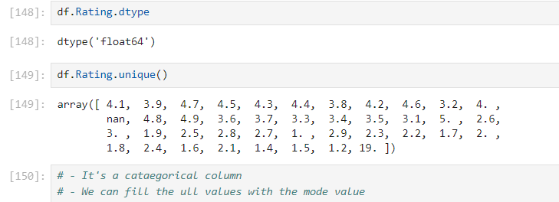
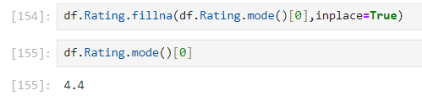

Slide 15
Encoding Categorical Variables
Encoding categorical variables is a critical step in data preprocessing for machine learning models, as most models require numerical input.
There are two approach:
Label encoding and one-hot encoding.

Slide 16
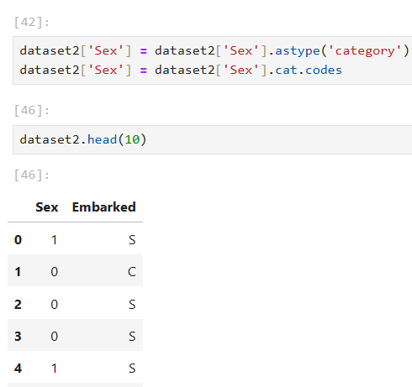
Label Encoding
It converts each category in a categorical variable to a unique integer.
When to Use: When the categorical variable has an ordinal relationship (e.g., low, medium, high).
When there are a limited number of categories.

Slide 17
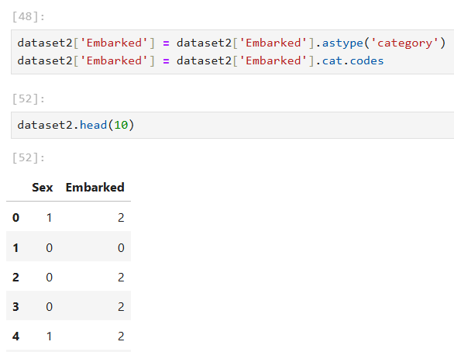

Slide 18
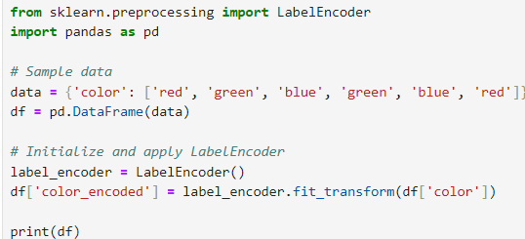
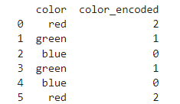

Slide 19


One-Hot Encoding
One-hot encoding converts categorical variables into a series of binary columns, each representing a unique category.
When to Use
When the categorical variable is nominal (no intrinsic order).
When you want to avoid introducing ordinal relationships.

Slide 20
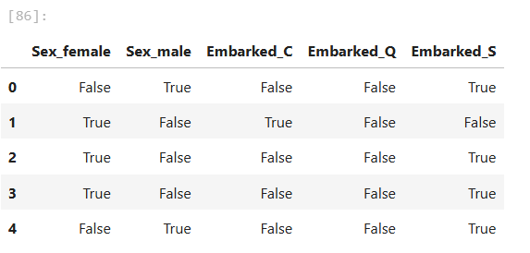
pd.get_dummies() is a function in the pandas library in Python used for one-hot encoding categorical variables.
In one hot encoding usually drop one column.

Slide 21
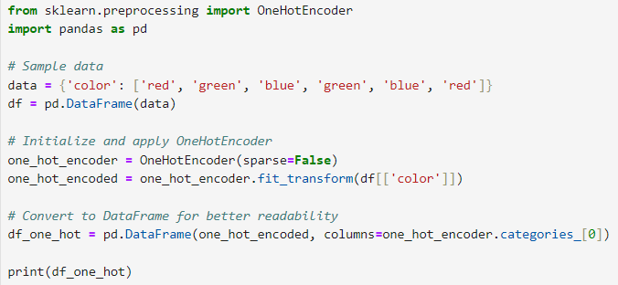
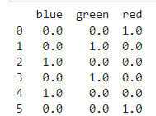

Slide 22
Handling Outlier
Identifying outliers:
Visualization-Based Detection:
Box plots
Histograms with normal distribution curve
Statistical Methods:
Z-Score (standard deviation approach)
IQR (Interquartile Range):
Values below Q1−1.5×IQR
Values above Q3+1.5×IQR.

Slide 23
Approaches to Handle Outliers
Capping method:
Using IQR or Z score
Transformation Approach:
Log Transformation
Square root Transformation
Box- Cox Transformation
Winsorization Method

Slide 24
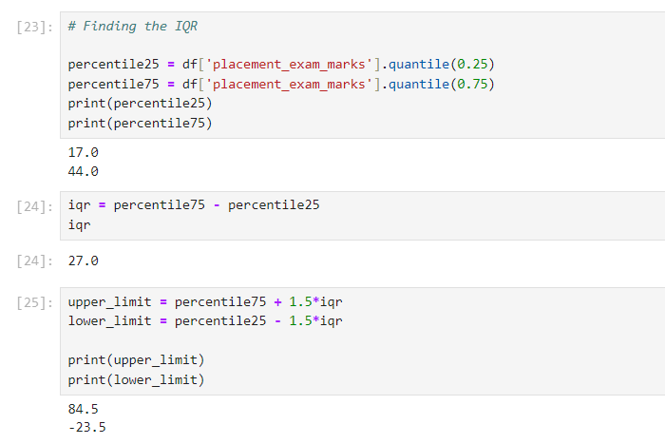
Finding Outliers Using IQR method

Slide 25
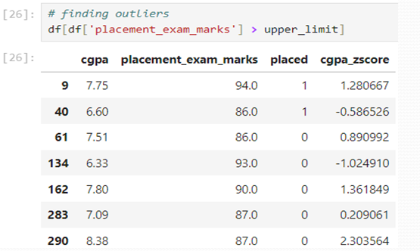
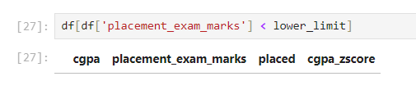

Slide 26
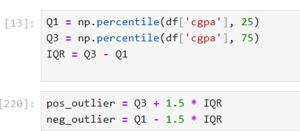

Slide 27
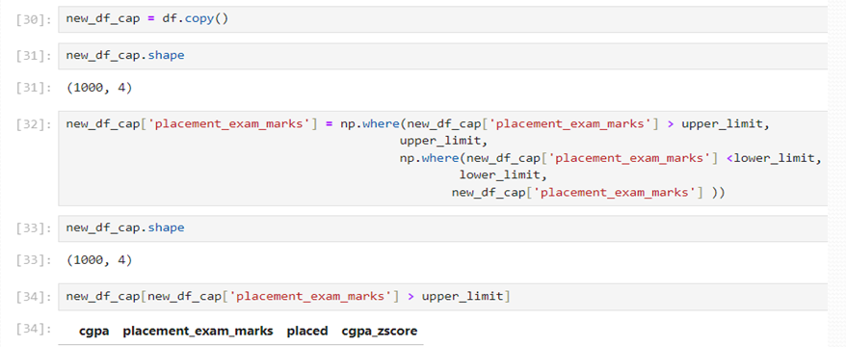
Handling outlier using capping by IQR

Slide 28
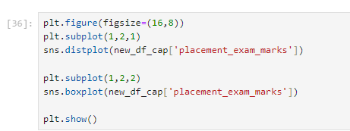
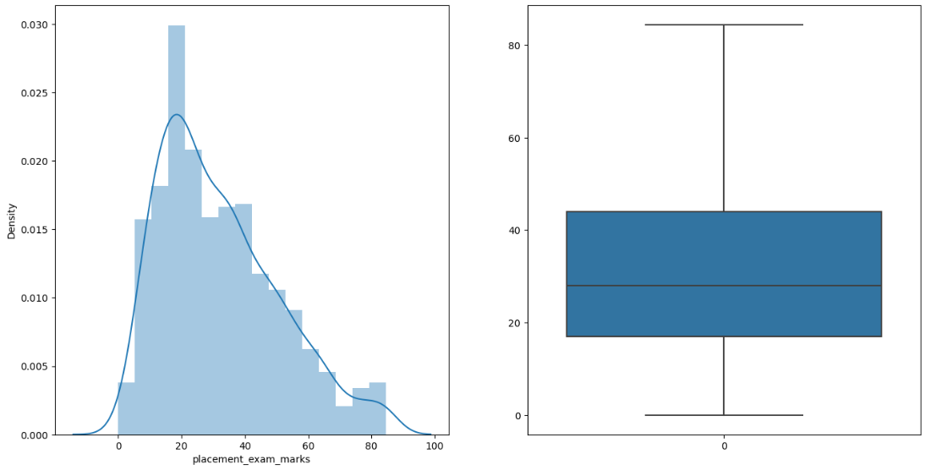
Distribution and box plot

Slide 29
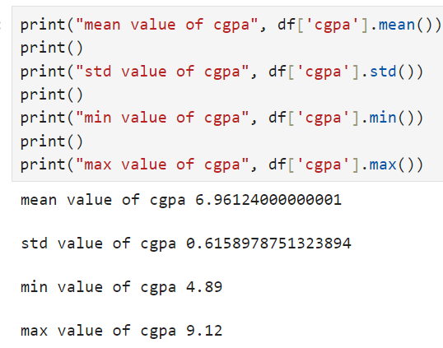
Handling outlier using capping by Z score:
Step1: find mean and standard deviation

Slide 30
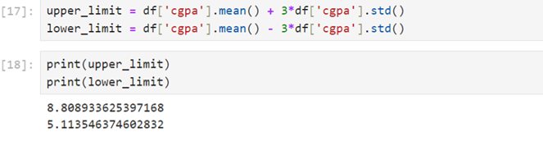
Step 2: Find minimum and maximum based on normal distribution parameters to identify an outlier

Slide 31
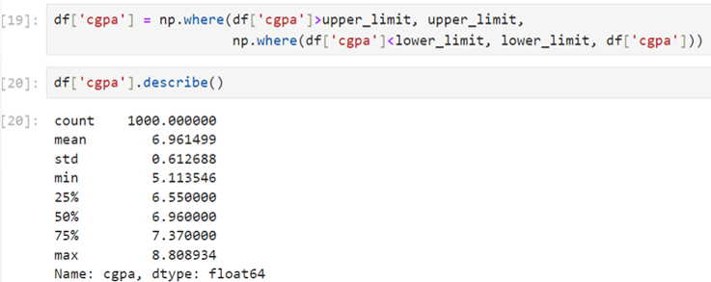
Step 3: Capping

Slide 32
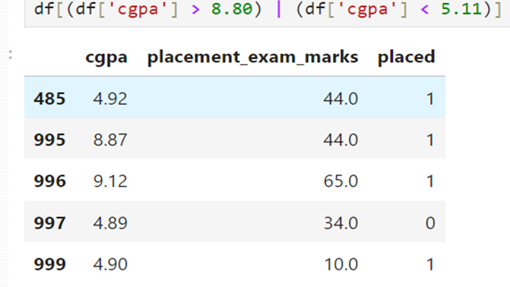
To view the outliers based on mini or max

Slide 33
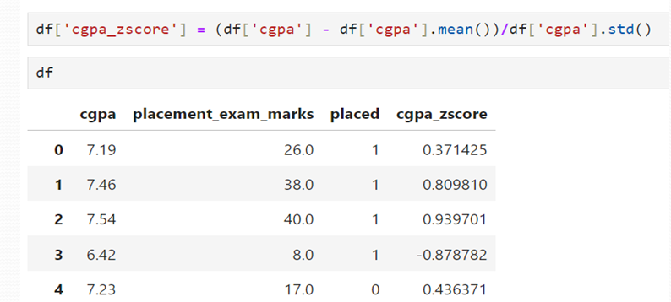
To Calculate Z-score

Slide 34
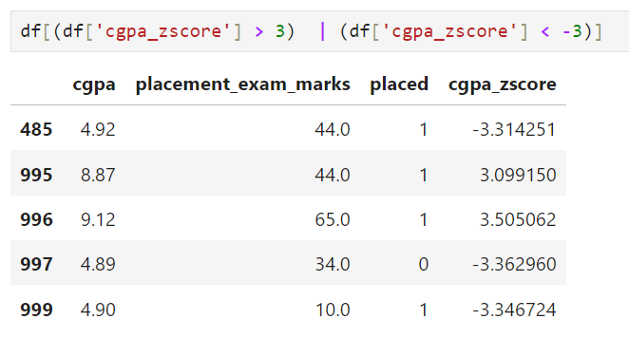
To view the outliers based on Z-score:

Slide 35
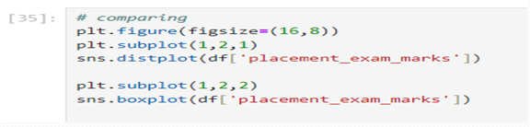
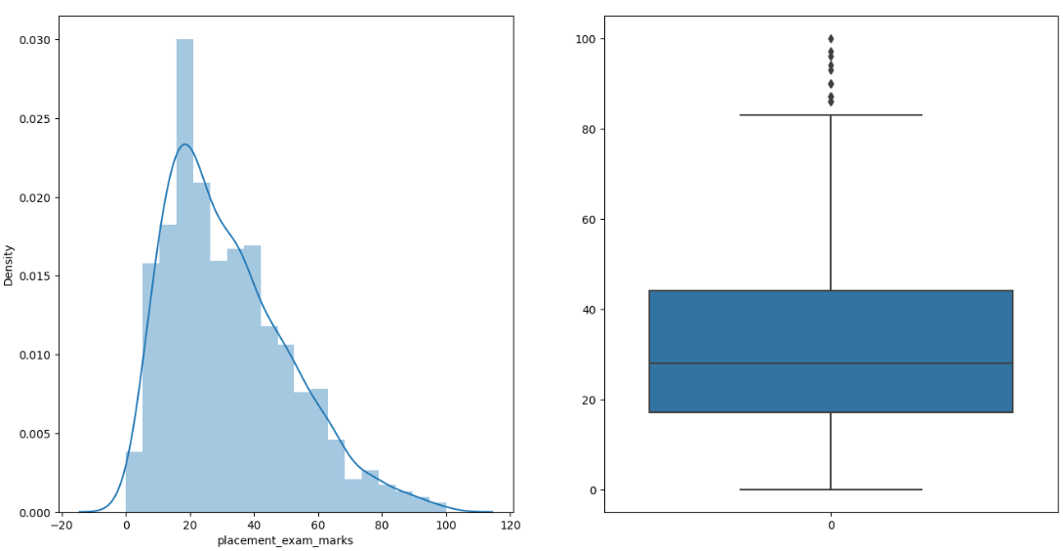
To visualize the outliers by distribution plot and boxplot:

Slide 36
Log Transformation
Logarithmic transformation is often used to reduce the effect of large outliers by compressing the range of data values.
Formula:
y=log⁡(x)
Works best when all values are positive (since log of zero or negative values is undefined).
Helps stabilize variance and normalize skewed distributions.

Slide 37
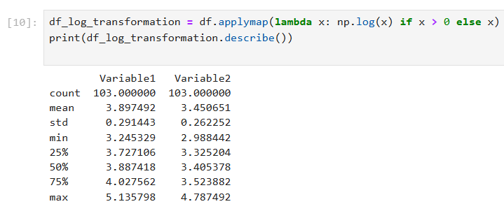

Slide 38
Square Root Transform
Square root transformation reduces the magnitude of large values but less aggressively than logarithmic transformation.
It works with zero values but not negatives.
Formula:
y=sqrt{x}

Slide 39
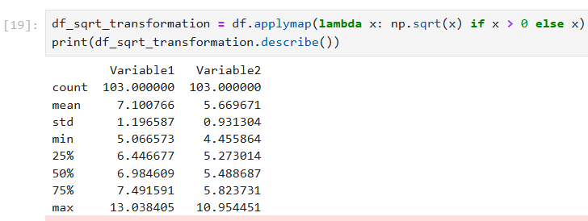

Slide 40
Box-Cox Transformation
The Box-Cox transformation is a family of power transformations that stabilize variance, make the data more normal-like, and reduce the impact of outliers.
Unlike logarithmic or square root transformations, the Box-Cox method includes an adjustable parameter (λ that determines the transformation applied.
When to Use
When data is not normally distributed and transformations like log or square root are insufficient.
To stabilize variance across different scales of data.

Slide 41
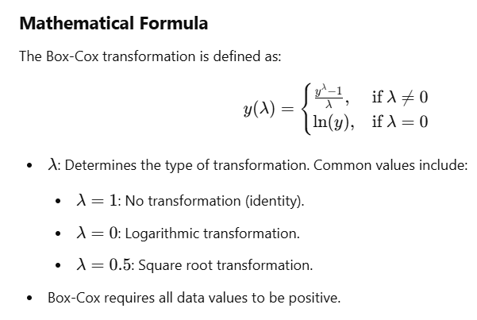

Slide 42
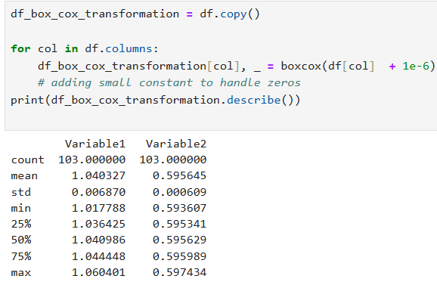

Slide 43
Winsorization:
Winsorization replaces extreme values with specified percentiles to limit the influence of outliers while retaining the dataset's size.
Steps:
Define lower and upper limits (e.g., 5th and 95th percentiles).
Replace values below the lower limit with the 5th percentile and above the upper limit with the 95th percentile.

Slide 44
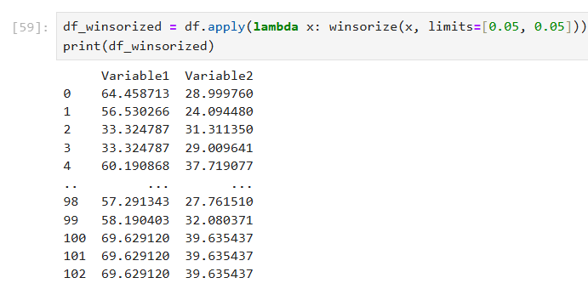

Slide 45

Feature Scaling
Importance of scaling features.
Methods: Standard Scaler, Min-Max Scaler, Normalizer.
We do not do feature scaling with dependent variables.
So Ist separate the data into independent and dependent variable.

Slide 46
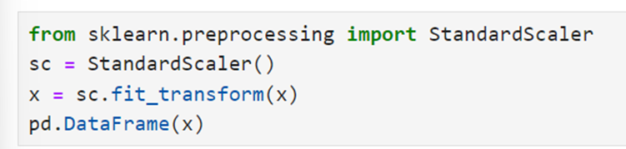
Standardization:
Scaling features to have zero mean and unit variance. This is particularly important for algorithms that rely on distance measures, such as SVM and k-NN.

Slide 47
When to Use Standard Scaler
The Standard Scaler standardizes features by removing the mean and scaling to unit variance.
Where "Remove the mean" means that for each feature in your dataset, you subtract the mean (average) value of that feature from all the values of that feature.
This process centers the feature around zero, ensuring that the transformed feature has a mean of zero.
This means each feature will have a mean of ‘0’ and a standard deviation of 1.
This ensures that each feature contributes equally to the model.

Slide 48
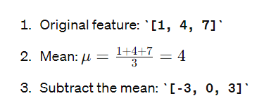
When your dataset contains features with different units (e.g., age in years, income in dollars, and height in centimeters), StandardScaler helps to bring all features to the same scale.
You are using algorithms that assume normal distribution of features.
X = np.array([[1, 2, 3],
[4, 5, 6],
[7, 8, 9]])
X_scaled = [[-1.22474487 -1.22474487 -1.22474487]
[ 0. 0. 0. ]
[ 1.22474487 1.22474487 1.22474487]]

Slide 49
When to Use Standard Scaler:
Algorithms that Assume Normal Distribution:
Linear Regression: Assumes that the relationship between the input and output is linear.
Logistic Regression: Assumes a linear relationship between the input features and the log-odds of the target.
Linear Discriminant Analysis (LDA): Assumes data is normally distributed within each class.
Support Vector Machines (SVM): Assumes features have similar scales for optimal performance.
Principal Component Analysis (PCA): Assumes the data is centered around the origin for variance maximization.
K-Means Clustering: Assumes features are on similar scales for effective distance calculation.

Slide 50
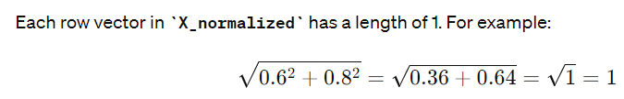
Normalizer:
Normalizer is suitable when the goal is to scale individual samples to have unit norm(length).
This technique is useful when the direction of the data points is more important than the magnitude of their distance from the origin.
Normalizing the data to unit norm ensures that the focus is on the direction of each sample.
Sample data X = [[3, 4], [1, 2], [4, 5]]
Normalized data: means sum of data point(3,4 = 1).
X = [[0.6 0.8 ] [0.4472136 0.89442719] [0.62469505 0.78086881]]

Slide 51
When to Use Normalizer:
Feature Comparison:
Cosine Similarity: When you want to measure the cosine similarity between samples. By normalizing, you ensure that the angle between vectors becomes the metric rather than their magnitude.
Clustering: When using clustering algorithms like K-Means, normalized data can improve the convergence speed and cluster quality, especially if the data has different scales.
Nearest Neighbor: When you want to perform k-nearest neighbors (KNN) classification or regression, normalizing ensures that all features contribute equally to the distance calculations.

Slide 52
4 Sparse Data:
When working with sparse data (data with a lot of zeros), normalizing can make algorithms like Support Vector Machines (SVM) and Principal Component Analysis (PCA) perform better by ensuring that features with more non-zero values don’t dominate.
5 Text Data:
TF-IDF: In Natural Language Processing (NLP), TF-IDF vectors are often normalized to have unit norm to account for the difference in document lengths and to focus on the relative importance of terms.

Slide 53
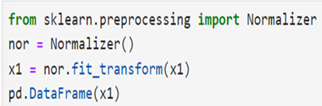

Slide 54
Concept of fit_transform and transform: When to Use
fit_transform: Use this on your training data to compute the necessary parameters(mean, standard deviation) and apply the transformation in one step.
fit the preprocessing transformers on the training data to learn the necessary parameters.
transform the training data using the fitted transformers.
transform: Use this on your test data (or any new data) to apply the transformation using the parameters computed from the training data.
For test data we do not use ‘fit’ and we are using the same parameters as calculated for training.

Slide 55
Converting data types using `pd.to_numeric`.

Slide 56
Common Data Types and Their Handling
Numerical Data:
Integers: Whole numbers.
Floats: Decimal numbers.
Handling: Ensure numerical columns are in the correct format and handle missing values appropriately.

Slide 57
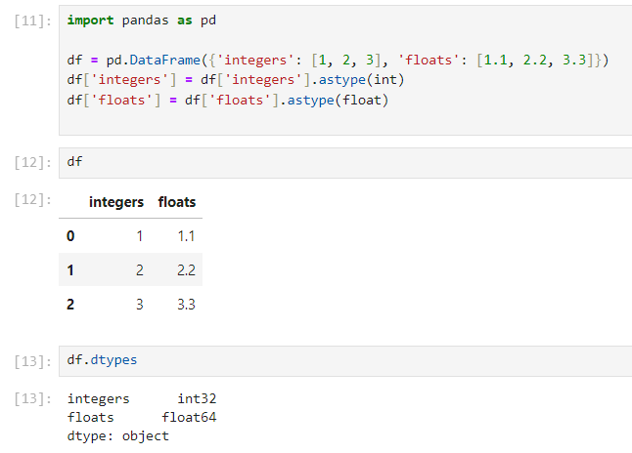
Numerical Data:

Slide 58
Categorical Data:
Nominal: Categories without a specific order (e.g., color: red, green, blue).
Ordinal: Categories with a specific order (e.g., rating: low, medium, high).
Handling: Encode categorical variables using techniques such as label encoding or one-hot encoding.

Slide 59
Label encoding:
Label encoding is a technique used to convert ordinal type of categorical data into numerical format.
It assigns a unique integer to each category in the categorical variable.
This is particularly useful for machine learning algorithms that require numeric input.
dataset[‘Col_Name'] = dataset[' Col_Name '].astype('category')
dataset[‘Col_Name'] = dataset[‘Col_Name'].cat.codes
convert the [‘Col_Name'] to categorical type using astype('category').
then use cat.codes to assign numeric labels to each category in the [‘Col_Name'] and create a new column with the encoded values.

Slide 60
One-hot encoding:
One-hot encoding is a technique used to convert Nominal type categorical data into a binary format, where each category is represented as a binary vector.
It creates new binary columns (also known as dummy variables) for each category, with a value of 1 indicating the presence of that category and 0 indicating absence.
After OHE drop one variable. Here is python code:
dataset = pd.get_dummies(dataset, columns = [‘Col_Name'])
Where:
“pd.get_dummies()” is a pandas function used for one-hot encoding categorical variables.
“columns=['Col_Name']” specifies the column(s) in the Data Frame that you want to encode.

Slide 61
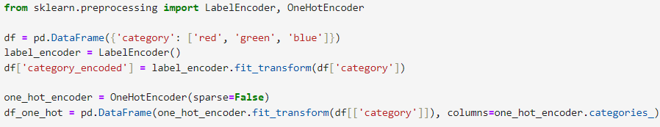
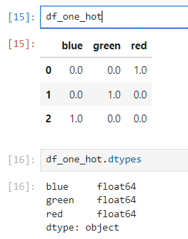
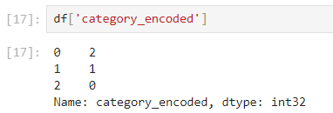
Categorical Data:

Slide 62
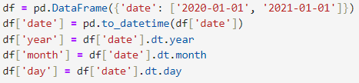
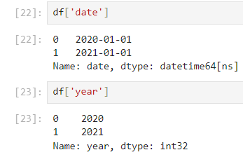
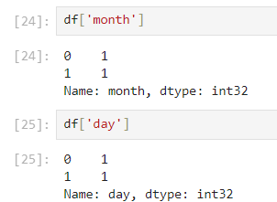
Datetime Data:

Slide 63
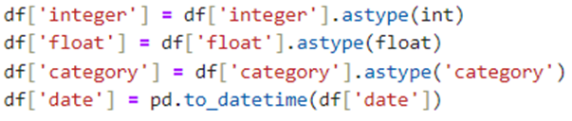
Convert Data Types:

Slide 64
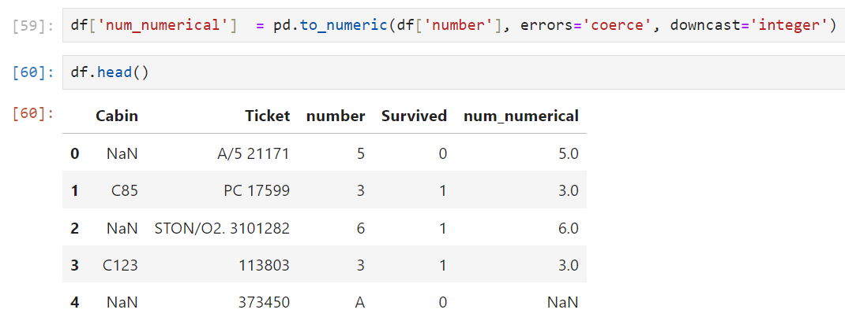
Example

Slide 65
pd.to_numeric(df['number'], errors='coerce', downcast='integer')
pd.to_numeric: This function is used to convert argument to a numeric type.
df['number']: This specifies the column number from the DataFrame df that we want to convert.
errors='coerce': This argument tells the function how to handle errors during the conversion process. Specifically:'coerce': This means that any values that cannot be converted to a numeric type will be set to NaN (Not a Number).
downcast='integer': This argument attempts to downcast the numeric type to the smallest possible integer subtype, which helps in saving memory.
For example, if all values can be represented by a smaller integer type (like int8), it will use that type instead of a larger one (like int64).

Slide 66
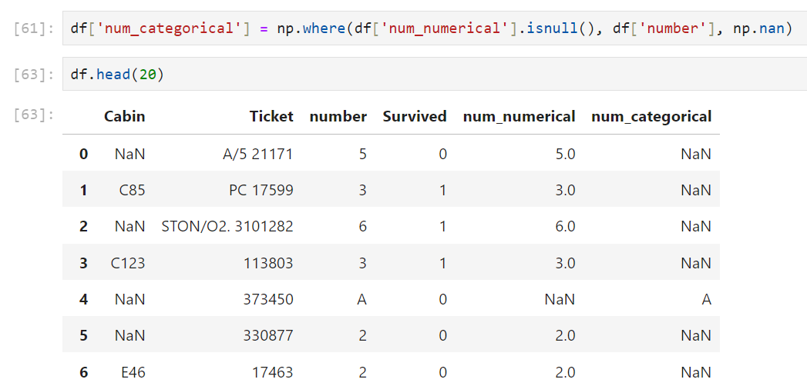

Slide 67
np.where(df['num_numerical'].isnull(), df['number'], np.nan)
np.where(condition, x, y):
This function from the NumPy library is used for element-wise selection from two arrays (x and y) based on a condition. It returns elements chosen from x or y depending on the condition.
condition: This specifies the condition to be checked.
x: The values to select where the condition is True.
y: The values to select where the condition is False.
2. df['num_numerical'].isnull():
This checks for NaN values in the num_numerical column of the DataFrame df. It returns a boolean Series where True indicates the presence of a NaN value and False indicates the absence of a NaN value.
3. df['number']:
This specifies the original number column from the DataFrame df, which contains the original values before any numeric conversion.
4. np.nan:
This specifies that NaN should be used where the condition is False.

Slide 68

Data Balancing
Importance of balanced datasets.
Data is said to be imbalance if twice of minority class is less than the majority class.
To find it, check the count in dependent variables.
Two popular approach to solve the problem:
Oversampling
SMOTE

Slide 69

RandomOverSampler
Simply duplicates random instances of the minority class to increase its representation in the dataset.
This can be effective but may lead to overfitting as the same instances are repeated multiple times.

Slide 70

SMOTE (Synthetic minority oversampling technique)
Generates synthetic samples by interpolating between existing minority class instances.
This technique creates more diverse samples compared to simple duplication, potentially reducing overfitting.

Slide 71

Cross Tabs for Feature Relationships

Slide 72


Slide 73


Slide 74


Slide 75


Slide 76


Slide 77


Slide 78
Exploratory Data Analysis (EDA):
Definition: Exploratory Data Analysis (EDA) is a critical step in the data analysis process. It involves examining and summarizing the main characteristics of a dataset, often using visual methods.
Here are some key steps and techniques you can use during EDA
Techniques:
Data visualization: Histograms, scatter plots, box plots.
Summary statistics: Mean, median, standard deviation.
Outlier detection: Identifying data points that deviate significantly from the rest of the dataset

Slide 79

What we can do in EDA

Slide 80


Slide 81


Slide 82


Slide 83


Slide 84


Slide 85


Slide 86
Visualization
Using plots for making inferences in machine learning involves visualizing data to understand its structure, relationships, and patterns, which can guide feature selection, model choice, and evaluation.

Slide 87
Visualization Techniques for EDA
Histograms
Box plots
Scatter plots
Pair plots
Correlation matrix and heatmaps
Bar plots
Count plots
Violin plots

Slide 88


Histograms
Purpose: Understand the distribution of individual variables.
Inference: Identify skewness, outliers, and the presence of multiple modes in the data.

Slide 89


Box Plots
Purpose: Summarize the distribution of a dataset.
Inference: Detect outliers, understand the spread and symmetry of the data.

Slide 90


Scatter Plots
Purpose: Visualize the relationship between two continuous variables.
Inference: Identify correlations, clusters, and potential outliers

Slide 91
Pair Plots (Scatterplot Matrix)
Purpose: Visualize pairwise relationships between multiple variables.
Inference: Detect relationships between pairs of features, spot trends, clusters, and outliers.

Slide 92

Correlation Matrix and Heatmaps
Purpose: Show the correlation coefficients between variables.
Inference: Identify highly correlated features that might be redundant.

Slide 93


Bar Plots
Purpose: Compare categorical data.
Inference: Understand the frequency distribution of categorical features.

Slide 94


Density plots
Density plots display the probability density function of a continuous variable. They are useful for visualizing the overall shape of the distribution and comparing multiple distributions.

Slide 95

Distribution plot
A distribution plot is a visualization that combines aspects of a histogram and a kernel density plot to show the distribution of a continuous variable.
It is useful for understanding the distribution of data points in a dataset and identifying patterns such as skewness, kurtosis, and the presence of outliers.
sns.histplot is used instead of sns.distplot.
The parameter kde=True adds the KDE line to the histogram

Slide 96


In recent versions of Seaborn (0.11.0 and later), sns.distplot has been deprecated.
Instead, you should use sns.histplot or sns.kdeplot for similar functionality. Here's how to create a similar plot using sns.histplot

Slide 97

Count Plots
Purpose: Show the counts of observations in each categorical bin.
Inference: Detect the distribution of categorical features.

Slide 98


Slide 99


Slide 100

Pie Plot
A pie plot (or pie chart) is a circular statistical graphic that is divided into slices to illustrate numerical proportions. Each slice represents a category's proportion to the whole dataset. Pie charts are useful for showing the relative sizes of parts to a whole, making it easy to compare the parts of a single categorical variable.

Slide 101


Slide 102


Slide 103
Feature Selection
Feature selection is the process of selecting a subset of relevant features (input variables) for building robust and efficient models. If number of features are too large to handle than it is wise approach to remove insignificant features.
Reason | Explanation
Improve model performance | Removes noise and irrelevant features that reduce accuracy.
Avoid overfitting | Less features = less complexity = better generalization.
Faster training | Reduces dimensionality, so algorithms run faster.
Model interpretability | Fewer features = easier to explain.
Remove multicollinearity | Helps avoid misleading model coefficients.

Slide 104
Filter Methods (Before model training)
chi2() (for classification)
f_classif / ANOVA F-test
Correlation matrix (df.corr())

Slide 105


Slide 106

Wrapper Methods (Model + Evaluation)
Recursive Feature Elimination (RFE)

Slide 107
Recursive Feature Elimination (RFE)
Purpose:
RFE is a feature selection method that iteratively removes less important features based on the model's performance, identifying the most influential features for predicting the target variable.
Mathematical Basis:
Feature Importance:
RFE uses an estimator (e.g., Logistic Regression, Random Forest, etc.) that provides feature importance, such as weights or coefficients.

Slide 108
Steps:
Train the model on the dataset.
Rank features based on their importance scores.
Remove the least important feature(s).
Repeat until the desired number of features remains.
Advantages:
Identifies the most critical features for the model.
Helps improve model performance by eliminating redundant or irrelevant features.
Works well with small to medium datasets.
Disadvantages:
Computationally expensive for large datasets.
Performance depends on the chosen estimator.

Slide 109
Code Example:
from sklearn.feature_selection import RFE
from sklearn.linear_model import LogisticRegression
from sklearn.datasets import load_iris
from sklearn.model_selection import train_test_split
# Load dataset
data = load_iris()
X, y = data.data, data.target
# Train-test split
X_train, X_test, y_train, y_test = train_test_split(X, y, test_size=0.3, random_state=42)
# Logistic Regression as estimator
logitR = LogisticRegression()
# Apply RFE to select top 2 features
selector = RFE(estimator=logitR, n_features_to_select=2, step=1)
selector.fit(X_train, y_train)
# Selected features
print("Selected Features:", selector.support_)
print("Feature Ranking:", selector.ranking_)

Slide 110


Slide 111
Embedded Methods (Model with built-in selection)
Lasso (L1 Regularization)
Decision Trees / Random Forest feature importances
XGBoost feature importance
PCA :Principal Component Analysis
Purpose:
PCA is a dimensionality reduction technique that transforms the dataset into a lower-dimensional space while preserving as much variance as possible.

Slide 112

PCA:Principal Component Analysis

Slide 113


Slide 114


Slide 115

Key Differences

